Slide 1
Do not talk or interrupt the student teaching the game.
Save your questions for the end because the instructor will probably cover what you want to know.
During game play, do not talk to the person whose turn it is unless they ask for help or clarification. Keep all non-game chatter to a minimum.
When you finish your turn say, “I’m done.”
Please be aware that analysis paralysis can really slow down a game. Use other players’ turns for thinking so that when your turn comes, you can act quickly.

Slide 2
Complete your gaming log, taking notes on what you think about the game, including your game.
Put yourself in the position of a fellow game designer, not just a player.
Think about all elements of the game (theme, mechanic, victory condition, board design, bits, etc) and imagine how the designer may have made those choices.
Is there anything you’d change? What was the best, coolest idea that the game designer had?

Slide 3
For your log, write about...
What worked for you?
What would you change?
How would you change the game?
What was the best, coolest idea that the game designer had?
What strategies did you use, and did they work?

Slide 4
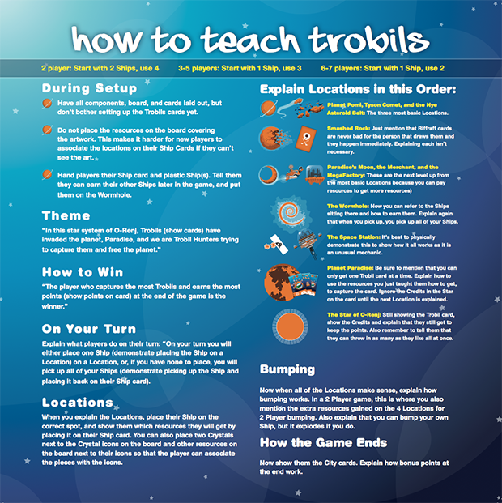

Slide 5
Article on How to Teach a Game

